Slide 1

ValidusAnalytics
EDGE over A.I.

Slide 2



About me..
Classical kathak dance
Trekking
Yoga

Slide 3

Session #1
JS is everywhere

Slide 4
Contents
1. about JavaScript
2. my journey with p5.js - generative art
3. HTML-CSS-JS : Frontend development

Slide 5
Introduction
1
JavaScript is everywhere

Slide 6

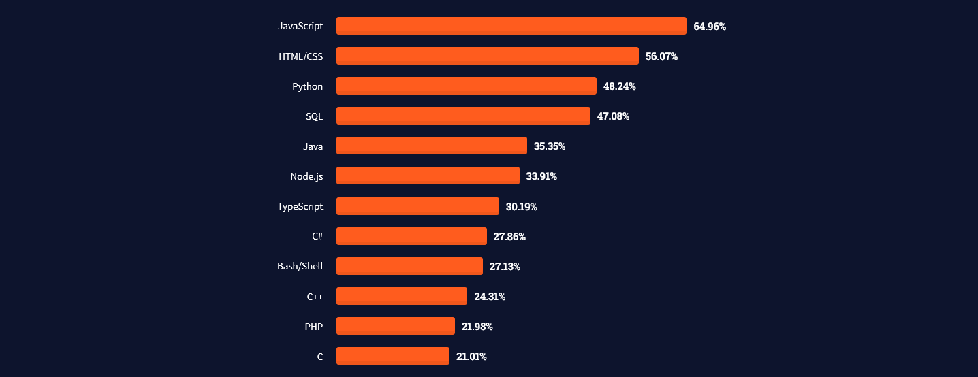
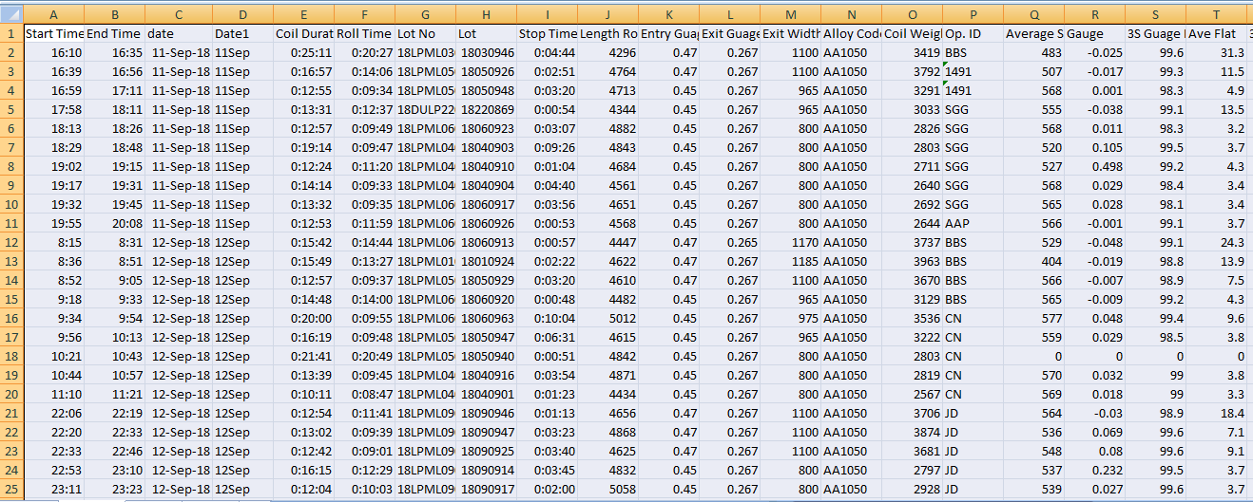
Popularity Indices - 2022
source

Slide 7
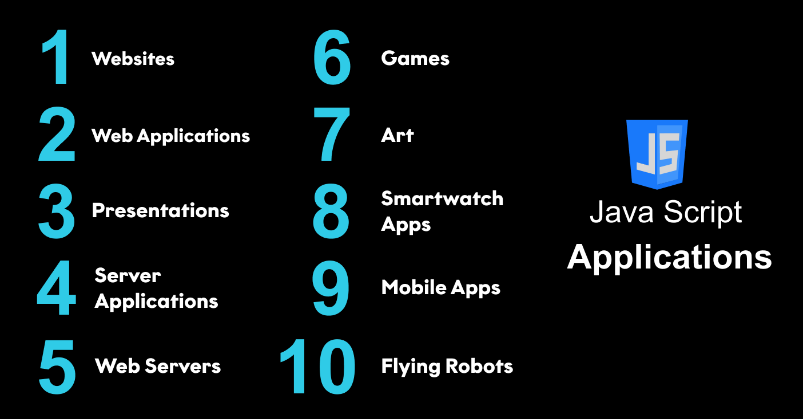
JS Applications
Notes:
JS is also used in EMBEDDED hardware devices and microcontrollers

Slide 8
You will need COFFEE
Lot of it !!!

Slide 9
my journey with p5.js
2
generative art

Slide 10

Generative ART
with
JavaScript

Slide 11
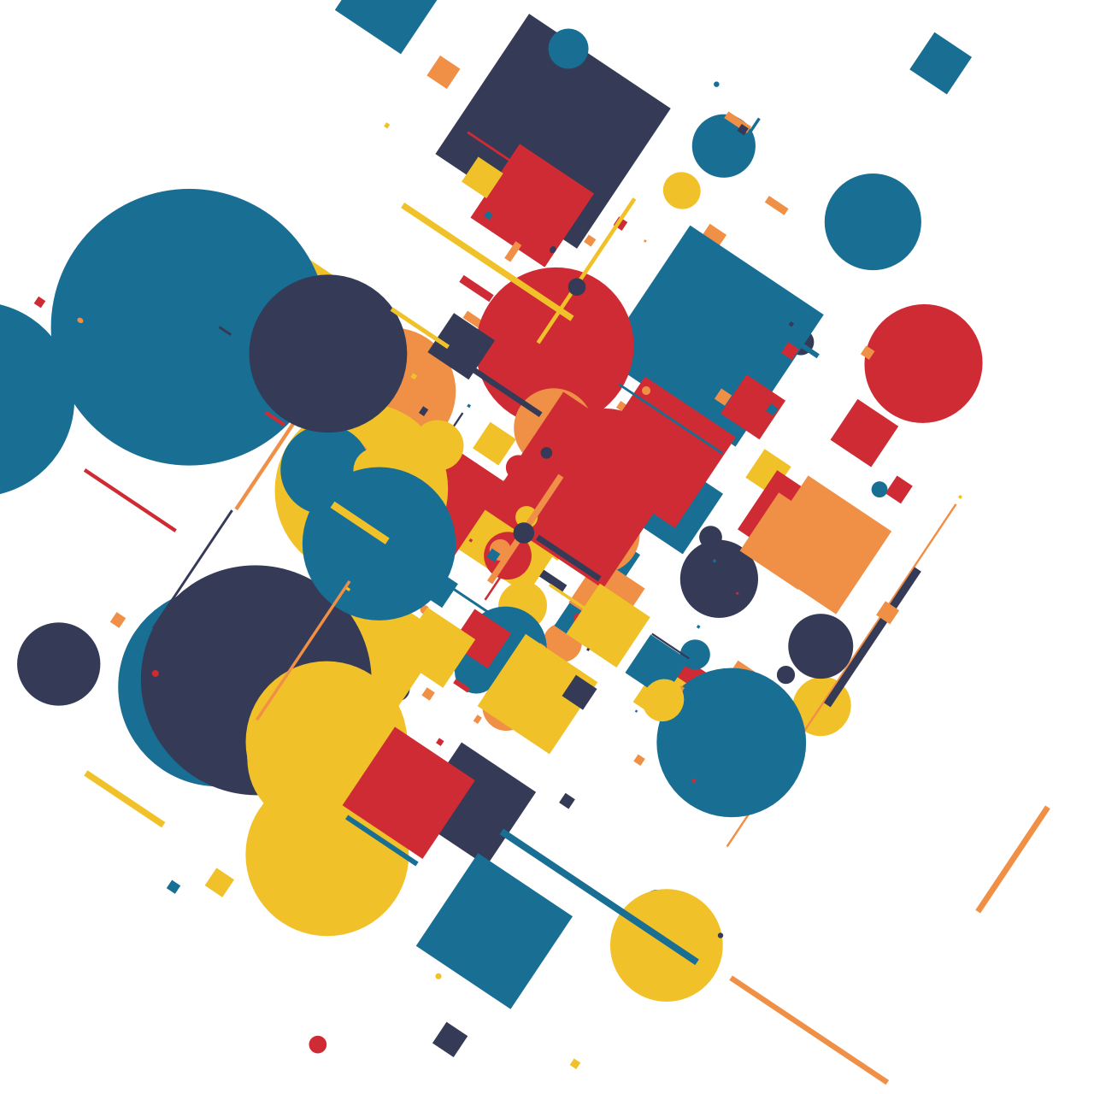
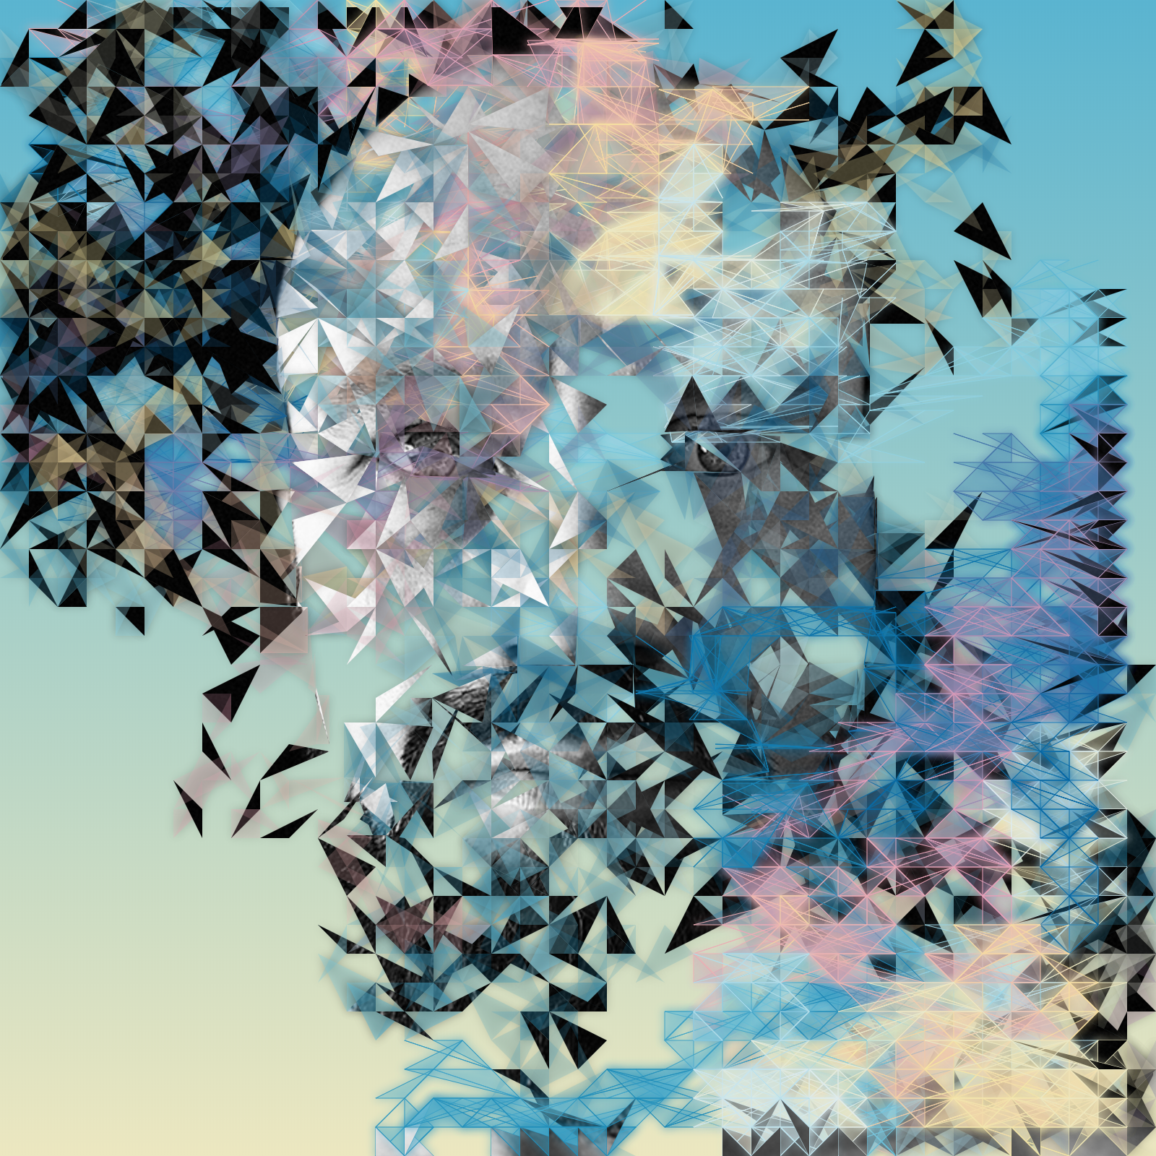

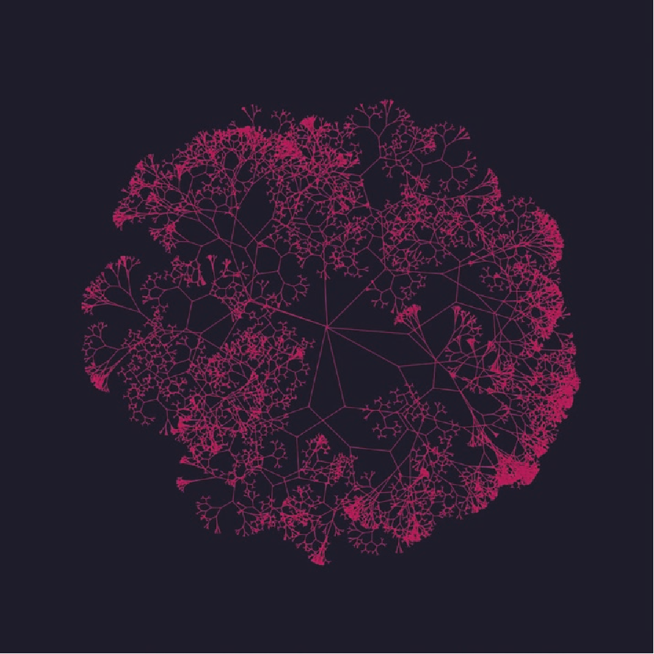
Some Examples of Generative ART

Slide 12
What is p5.js ?
JavaScript
JavaScript Library
Library for creative coding
Visualisation of math equations
Tool for GENERATIVE ART
VUE
D3
p5.js

Slide 13
Why p5.js ?
Works in the browser without the need of installation.
Easy to begin.
Equivalent to creating visual art full of beauty.
Immediate output makes it more convenient.

Slide 14
p5.js user interface
p5.js
Fourier Series animation to create a SQUARE wave..

Slide 15
p5.js Examples
Creating Patterns
Square pattern 1
Square pattern 2
Animation
Planets
Trees
Models
Structure
Heart
Model
Greeting Cards
Diwali Greeting
Christmas Greeting
Notes:
Sq pattern : Math.random wrapped as Random() in p5.js
Using widgets for eg : slider to control the size of the square.
STRUCTURE : use of WEBGL( web graphics library ) as well as ‘2d’ context for eg CANVAS tag in HTML
HEART : CAD images are difficult to visulaise… convert the CAD file to .obj extension and create a 3D effect
Christmas Greeting : add sound to the frontend overlay transparent CANVAS for various elements

Slide 16
HTML-CSS-JS
3
Best friends forever

Slide 17
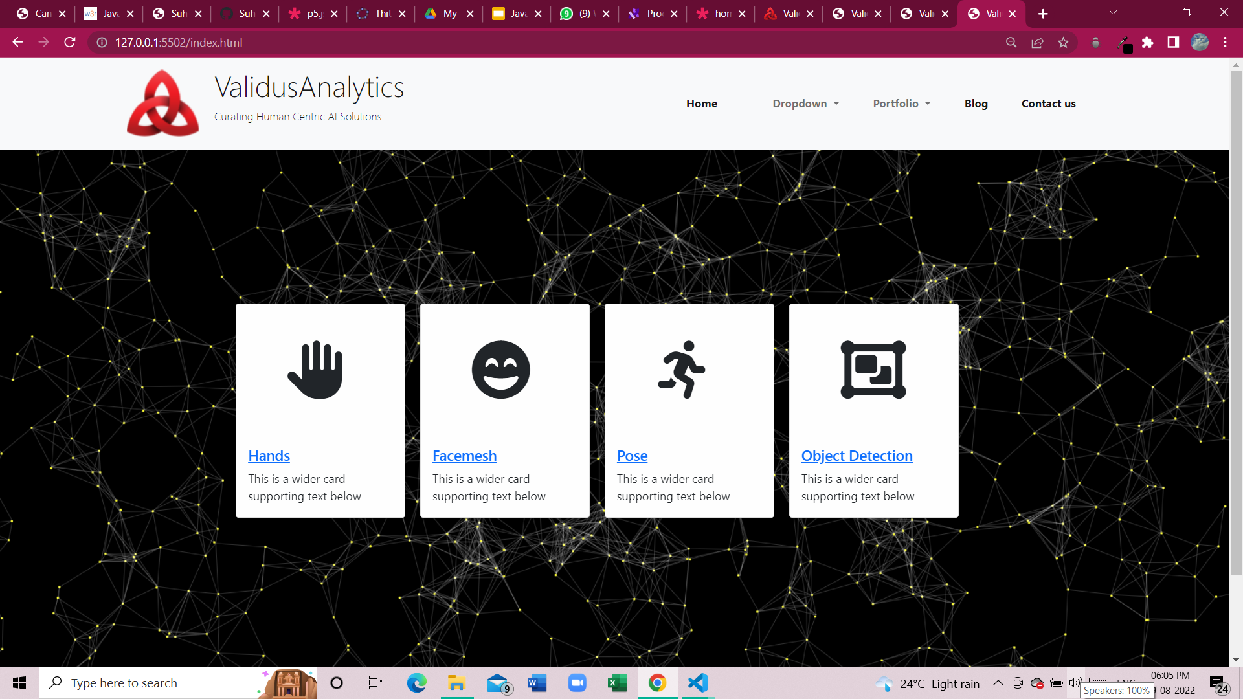
BROWSER based A.I demos
Show and explain your web, app or software projects using these gadget templates.

Slide 18
Thank you !!
You can find us at
info@validusanalytics.in

